Slide 1
SHARMA SUPERMARKET STORE
STORE PERFORMANCE & BUSINESS INTELLIGENCE DECK
Analysis Window: 2026-09-08 to 2026-09-08 • Period: TODAY
Generated by Supermarket AI Assistant • 08 September 2026
Total Sales
Bills Finalized
GST Collected
Low Stock Alerts
₹1,822.00
7 Bills
₹124.50
0 SKUs

Slide 2
Sales & Financial Key Metrics
High-level financial and operational indicators for Today
Gross Revenue
Invoices Finalized
Average Daily Run-rate
₹1,822.00
7 Bills
₹1,822.00
Total settled bill sales
Customer transactions count
Daily sales velocity
Average Bill Value
GST Tax Collected
Khata Outstanding Dues
₹260.29
₹124.50
₹3,000.00
Average basket size per customer
Total CGST + SGST collected
2 active customer balance
💡 Sales insight: Generating an average of ₹1,822.00/day with an average ticket size of ₹260.29.

Slide 3
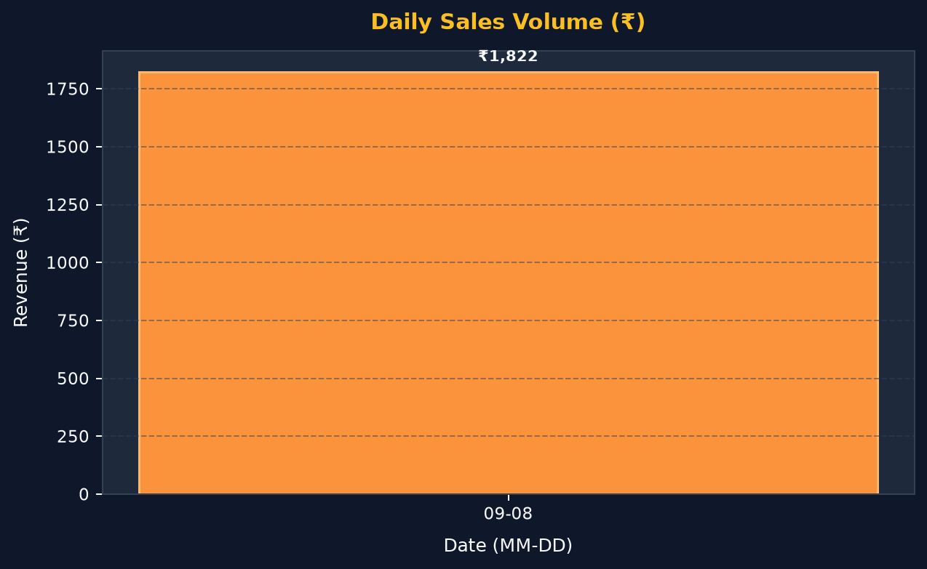
Sales Velocity & Daily Revenue Trend
Daily progression of finalized sales from 2026-09-08 to 2026-09-08
Trend Highlights
Peak Day
₹1,822.00
2026-09-08
Active Days
₹1,822.00 Total
1 Days tracked
Daily Run-rate
₹1,822.00/day
Period Average
Average Ticket
₹260.29/bill
7 total transactions

Slide 4
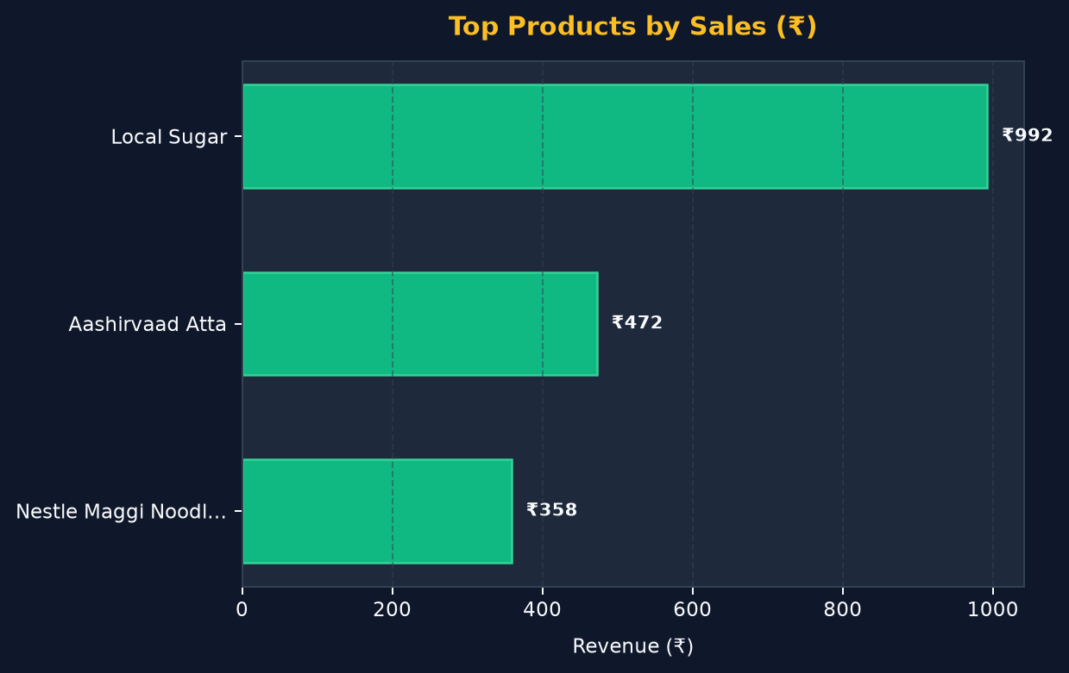
Top Performing Products (Revenue & Volume)
Best selling items ranked by total sales revenue
Product Sales Breakdown
Product Name
Qty Sold
Revenue
1. Local Sugar
21 kg
₹992.28
2. Aashirvaad Atta
9 kg
₹472.50
3. Nestle Maggi Noodles
19 pkt
₹358.72

Slide 5
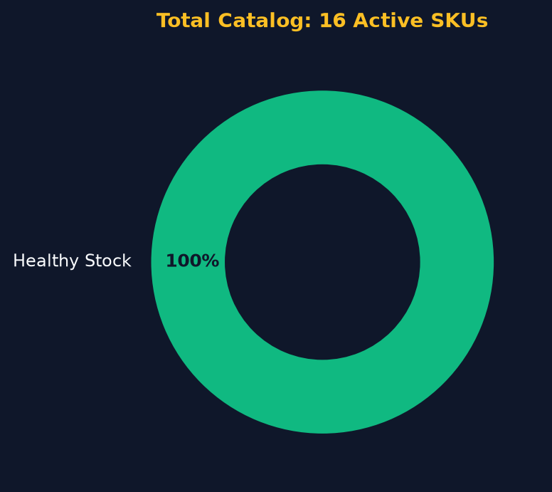
Stock Health & Inventory Status
Catalog SKU health, out-of-stock risk assessment, and reorder alerts
Critical Stock Reorder Alerts
✅ Excellent! All products are well above reorder levels.
All 16 active SKUs are sufficiently stocked.

Slide 6
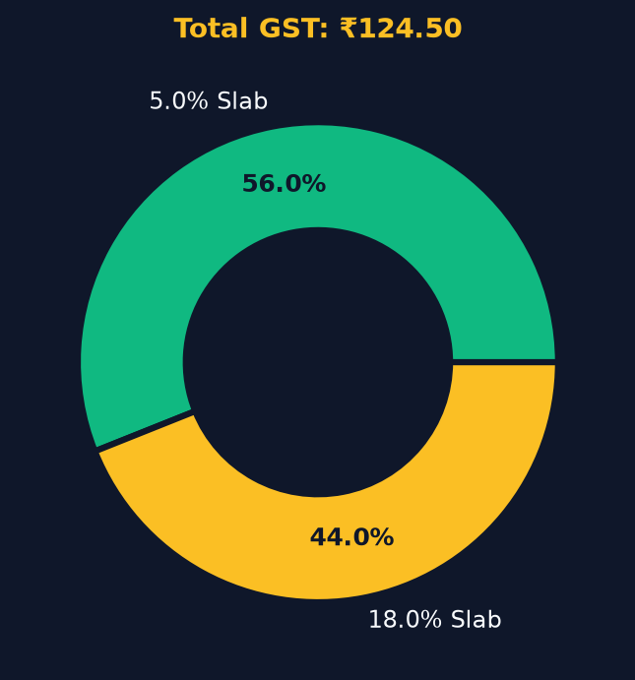
GST Collection & Tax Compliance
Statutory GST breakdown across tax slabs (CGST + SGST)
GST Slabs & Collections Summary
Taxable Turnover
Central GST (CGST)
₹1,699.00
₹62.25
State GST (SGST)
Total Tax Collected
₹62.25
₹124.50
Slab
Taxable (₹)
CGST (₹)
SGST (₹)
5.0% GST
₹1,395.00
₹34.89
₹34.89
18.0% GST
₹304.00
₹27.36
₹27.36

Slide 7
Customer Credit Ledger & Payment Mix
Customer credit receivables and transaction payment channels
Credit Ledger Summary
Top Customer Balances (Receivables)
Total Outstanding Receivables
Customer Name
Phone
Balance Due
₹3,000.00
1. Ramesh Patel
9876543214
₹2,300.00
2. Siva
—
₹700.00
Active Accounts with Dues: 2 Customers
Payment Channels Mix
• UPI
5 bills
₹1,140.00
• CASH
2 bills
₹682.00

